Slide 1
EDA ASSIGNMENT- CREDIT RISK ANALYSIS
BY
ANUSHA VL

Slide 2
PROBLEM STATEMENT
Due to the Insufficient or Non-existent credit history the loan providing companies find it difficult to verify the customers who are applying for loan.Some customers used this situation to delude the loan providing company,took loan and default from repaying amount back to company.This create huge loss to the company
Here we need to use EDA to analyse the Patterns present in the given data and help the customer finance company who lends various types of Loans by giving usefull Insights which inturn ensure that Applicant capable of Loan repayment are not been Rejected from receiving Loan
On receival of an Application for loan,the Approval depends on Applicants profile like Salary,Age,his other assets etc. Two types of risks are associated with the bank’s decision:
If the Applicant is an Ontime payer ,then rejecting the Loan will result in big loss to the Company
If the Applicant is a Defaulter ,then approving the Loan will generate high financial loss to the Company

Slide 3
The dataset given contains the information about the loan application at the time of applying for the loan.
It contains two categories:
The client with payment difficulties:he/she had late payment more than X days on at leastone of the first Y instalments of the loan in our sample
All other cases:All other cases when the payment is paid on time

Slide 4
OBJECTIVE
Our Objective of this case study is the recognize the patterns which demonstrate which group of clients has payment difficulties and which group wont have difficulties in their installments.Thus help the company to take precautions while lending loan to these groups

Slide 5
DATA UNDERSTANDING
The dataset has 3 files as explained below:
1. 'application_data.csv' contains all the information of the client at the time of application. The data is about whether a client has payment difficulties.
2. 'previous_application.csv' contains information about the client’s previous loan data. It contains the data on whether the previous application had been Approved, Cancelled, Refused or Unused offer.
3. 'columns_description.csv' is data dictionary which describes the meaning of the variables.

Slide 6
STEPS INVOLVED
Understand the Domain and Variable meanings with the help of Data Dictionary
Import the Application data as App_data
Check the Structure or Metadata of the data
Data Cleaning:
1. Remove some columns which not assumed to be usefull in Analysis
2. Missing value check:
a. Drop columns with missing percentage > 40
b. This along with removal reduce columns from 122 to 47
c. Categorical data:Impute with mode /create new ‘Missing’ category
d. Numerical:Impute with mean.For outlier columns impute with median
3. Check and Correct Incorrect data
a. XNA:Replace with mode or ‘Unkown’
b. Negative values:change to positive using abs and convert to Year format and rename for better readability

Slide 7
Outlier Analysis:
Use Upper & Lower whisker of boxplot to identify Outliers
Bucket some Numerical columns for better Analysis
Check Data Imbalance
Divide App_data to two based on Target variable ‘TARGET’
Univariate Analysis:
1. Done Univariate Analysis with help of loops for unsegmented data with countplot and distplot
2. Done Univariate Analysis for categorical columns for TARGET_0 & TARGET_1 df using countplot,Barplot and Piechart
Bivariate Analysis:
1. Done Numerical Bivariate using Scatter plot
2.Done Categorical,Numerical using boxplot
Multivariate Analysis:
1. Done using Pairplot and boxplot
Done Correlation using Heatmap and find Top 10 correlation for both TARGET_0 & TARGET_1

Slide 8
Load Previous Application data as ‘Prev_data’
Repeat same steps till univariate and bivariate Analysis except column dropping
Merge both datasets to new df ‘Merged_data’
Remove some more columns which are not needed in Analysis
Rename some columns to identify common name columns in both sets separately
Do Univariate and Bivariate Analysis

Slide 9
APPLICATION DATA ANALYSIS

Slide 10
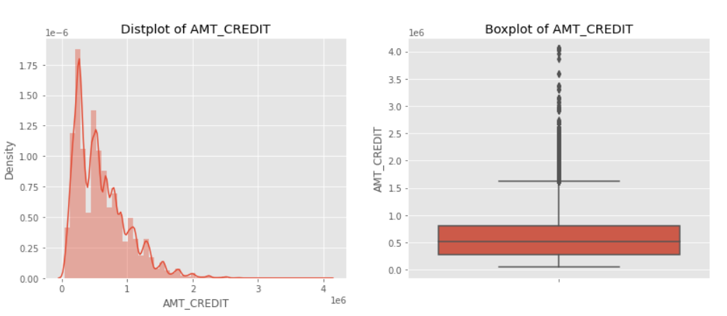
OUTLIER ANALYSIS OF AMT_CREDIT
Most of the values is in range of 2 and 8 lakhs
Above around 1.6 million ,many values(outliers) can be identified above Upper Whisker

Slide 11
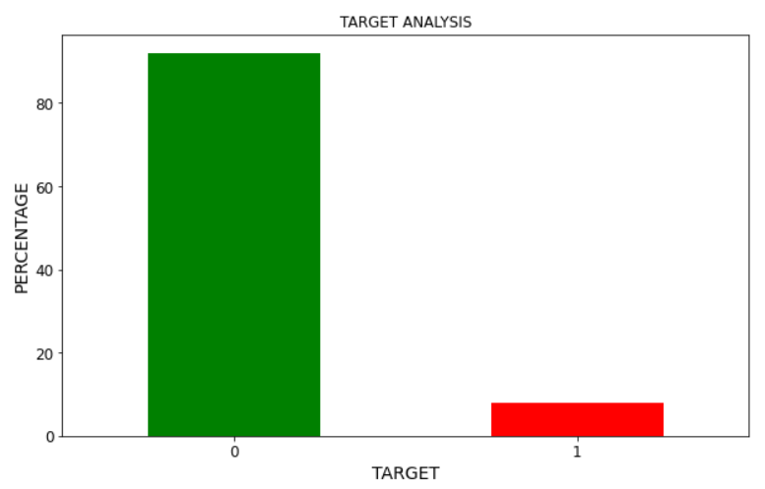
DATA IMBALANCE
There is data imbalance in the dataframe and ratio of it is 11.38

Slide 12
UNIVARIATE ANALYSIS

Slide 13
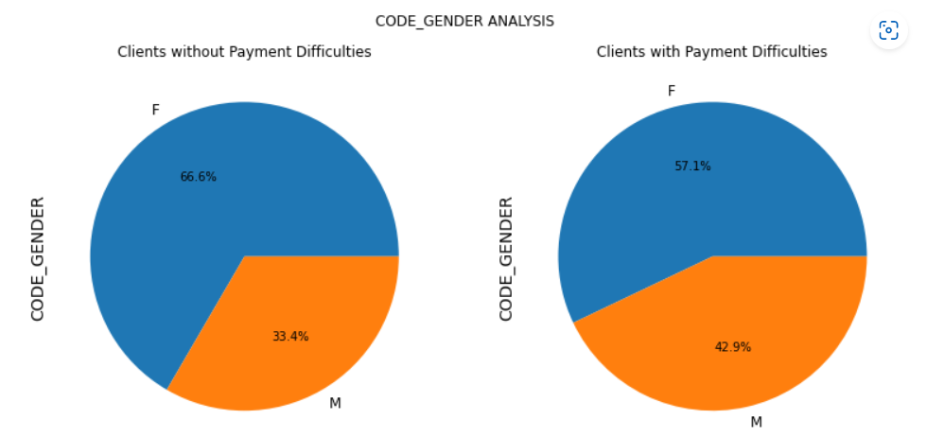
GENDER ANALYSIS
Default percentage is more for Male clients than Female Clients
Female Ontime Payment percentage is higher than payment difficulty percentage

Slide 14
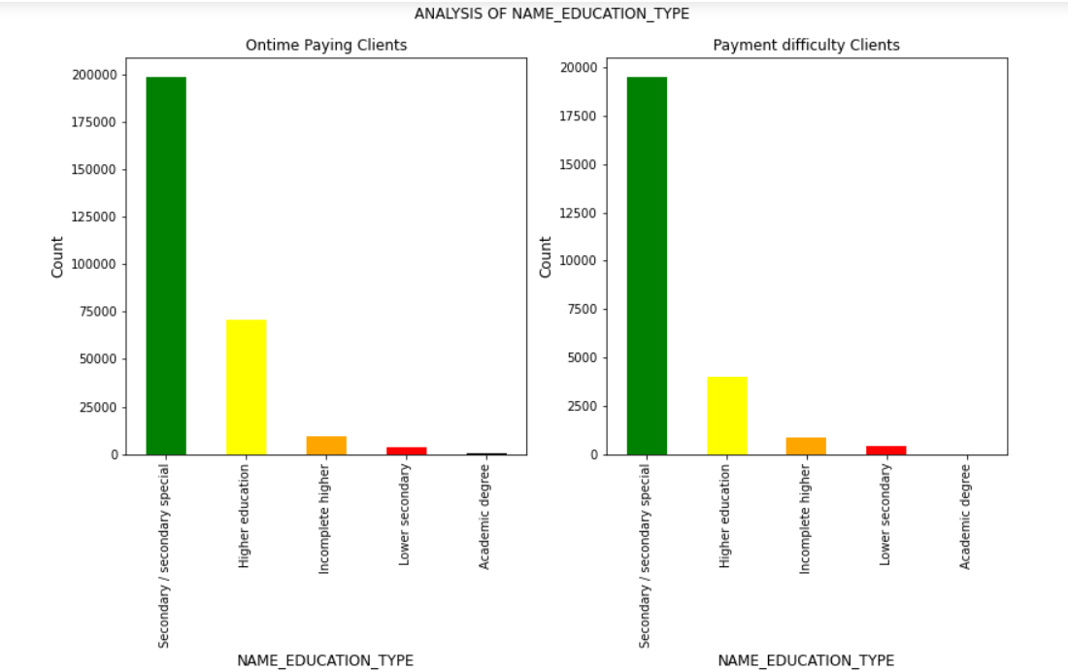
TYPE OF EDUCATION ANALYSIS
Secondary/secondary special is high in both categories
Customers with Higher Education and Academic degree have higher ontime payments than defaulters and this can be because they are settled than others

Slide 15
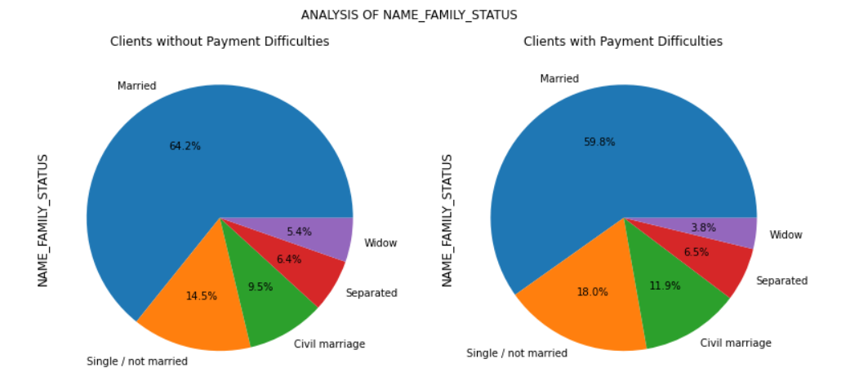
FAMILY STATUS ANALYSIS
Married and Widow Ontime payment percentage is higher than Defaulting category
Single/not married has more difficulty in repayment followed by Civil marriage

Slide 16
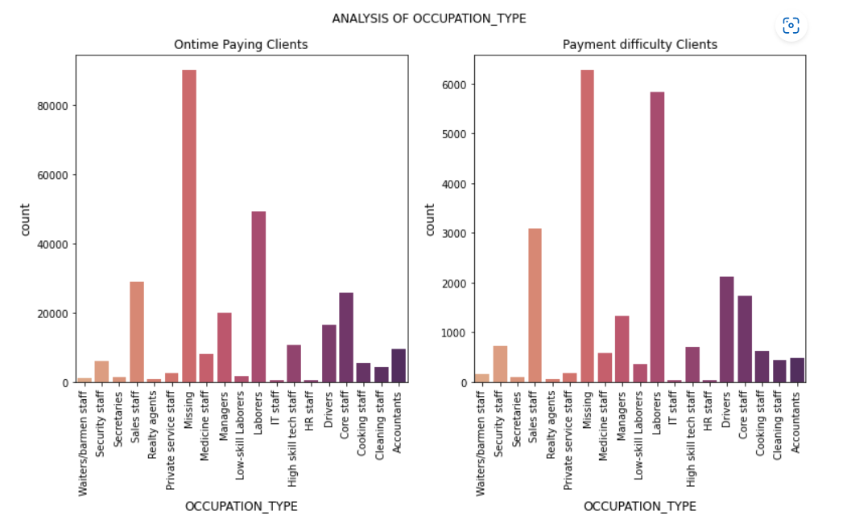
OCCUPATION TYPE ANALYSIS
Laborers are highest defaulters.People with higher jobs tend to pay loan ontime

Slide 17
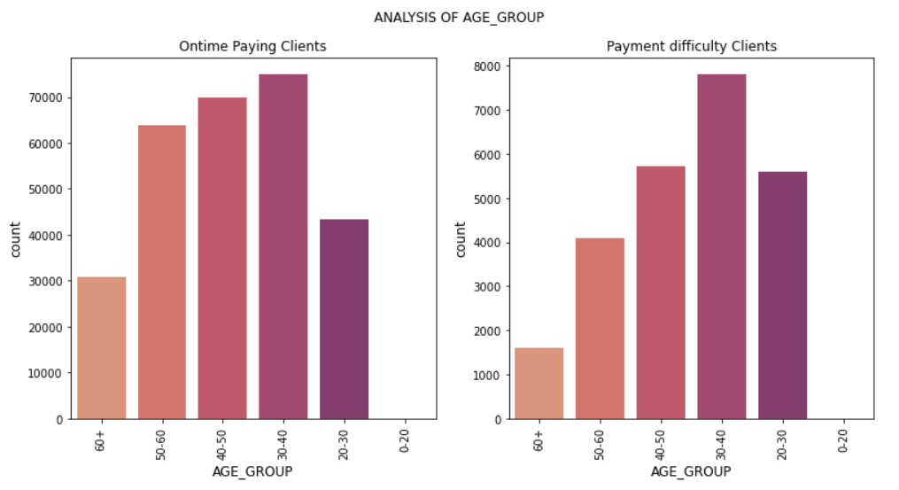
AGE ANALYSIS
20-30 category has more number defaulters compared to ontimers
30-40 age group has most ontime payers and defaulters.This may be because this age is when people become settled and also this is time when people got more responsibilities

Slide 18
BIVARIATE ANALYSIS

Slide 19
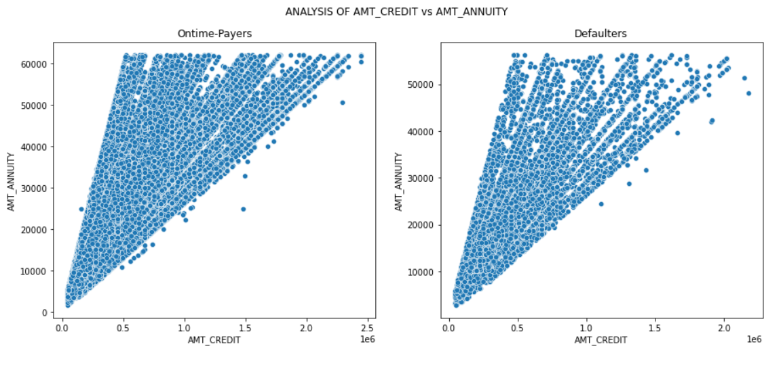
CREDIT AMOUNT Vs ANNUITY
we can see a positive correlation between credit amount of loan and loan Annuity.But Outliers are there

Slide 20
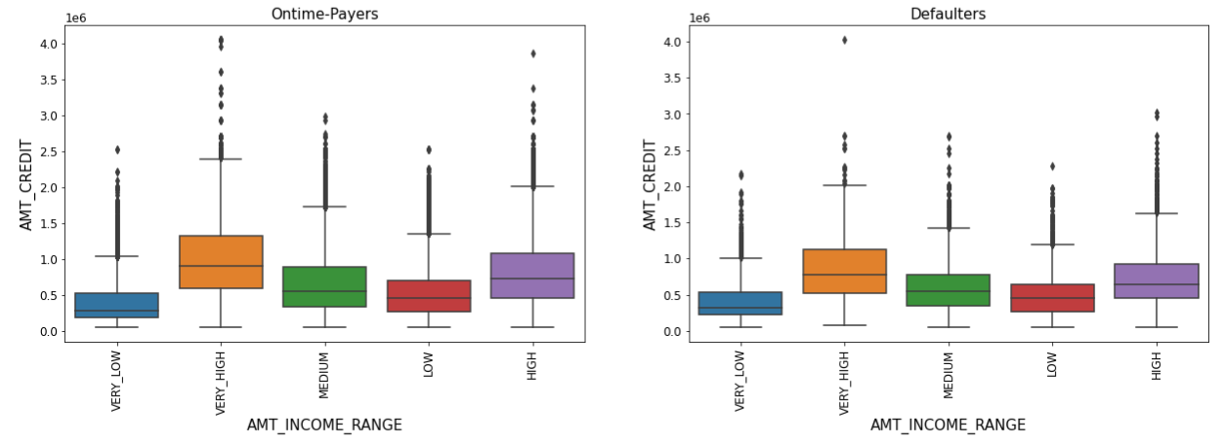
INCOME Vs CREDIT AMOUNT
High and Very_High got more credit amount than lower income categories and their presence is high in Ontime payers category.Also their median value is also high
Very low and low income one receive low credits and defaults more

Slide 21
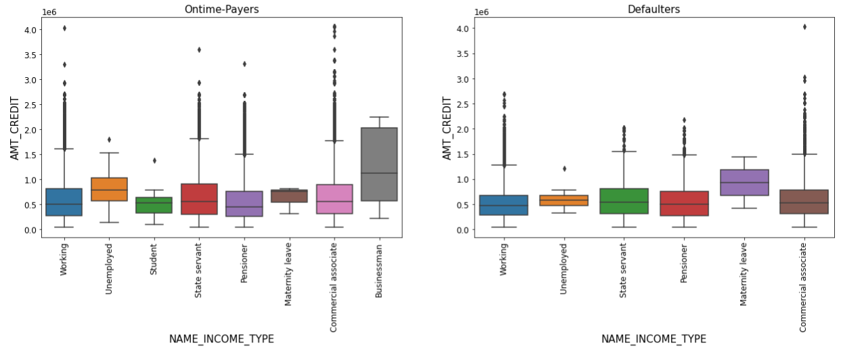
INCOME TYPE Vs CREDIT AMOUNT
Bussinessman who got high loan amount tends to pay it ontime
Similarly Student eventhough credit amount is low tends to pay ontime
But Maternity leave clients eventhough their representation is less in data tends to have more payement difficulty than ontime payment
Maternity leave,Businessman has no outliers

Slide 22
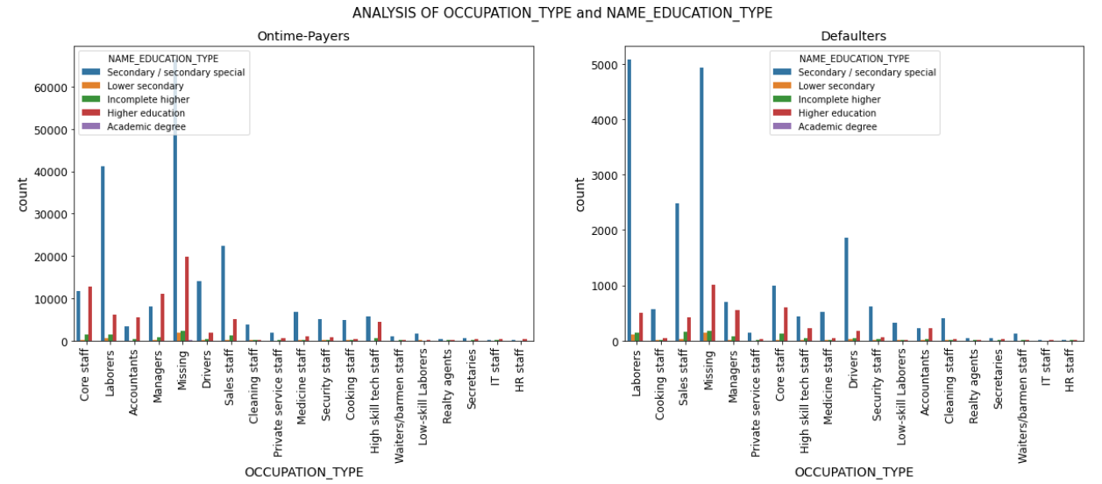
EDUCATION TYPE Vs OCCUPATION
Laborers with secondary education with payment difficulty is more than without difficulty in payment followed by sales staff and drivers
As education and job is on higher grade ,payment difficulty decreases

Slide 23
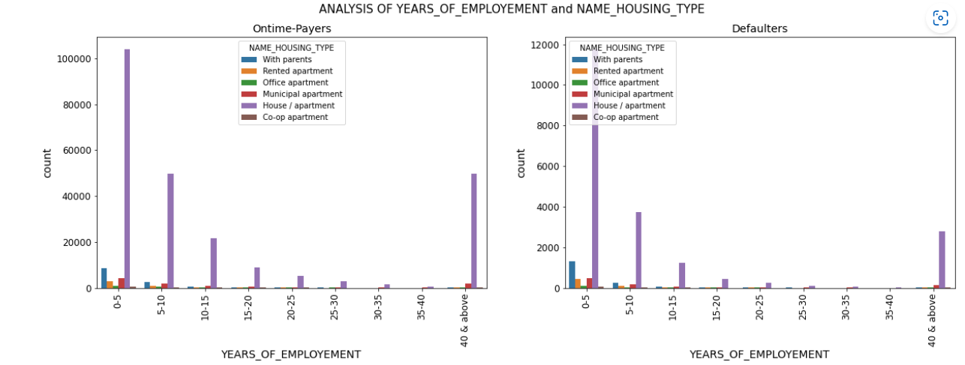
HOUSING TYPE Vs JOB EXPERIENCE
Clients with less experience and House/apartment as housing situation is first in both cases.Less experienced low income ones may be defaulters
As experince increases for all categories of housing type payment difficulty decreases and its obvious

Slide 24
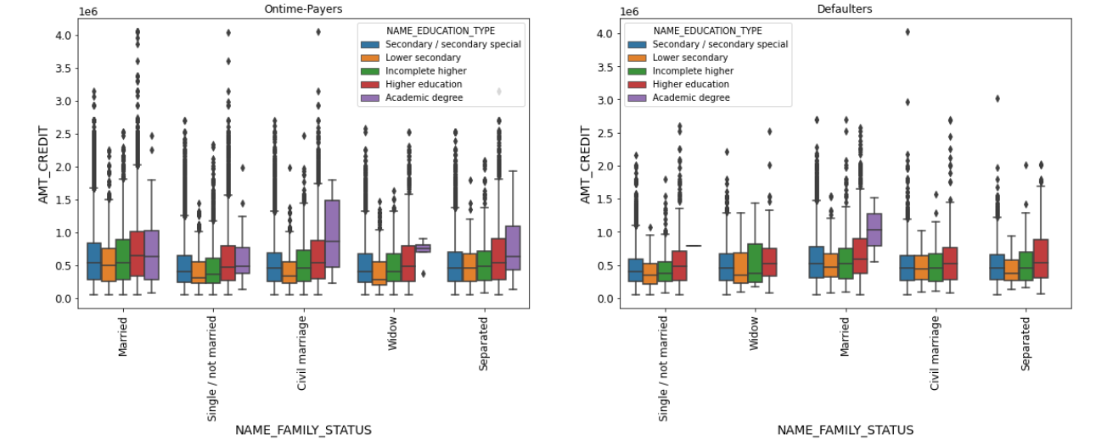
MULTIVARIATE CREDIT Vs FAMILY STATUS Vs EDUCATION TYPE
Married Academic degree having high credit has difficulty in loan repayment
But when considered all other Family_status categories we found that people with Academic degree are paying loan ontime and also have credit amount high
Higher Education,Secondary Education have higher outliers in Ontime_payers credit amount
Civil marriage and Separated cases have most credit in upper quartile.

Slide 25
PREVIOUS APPLICATION

Slide 26
UNIVARIATE ANALYSIS

Slide 27
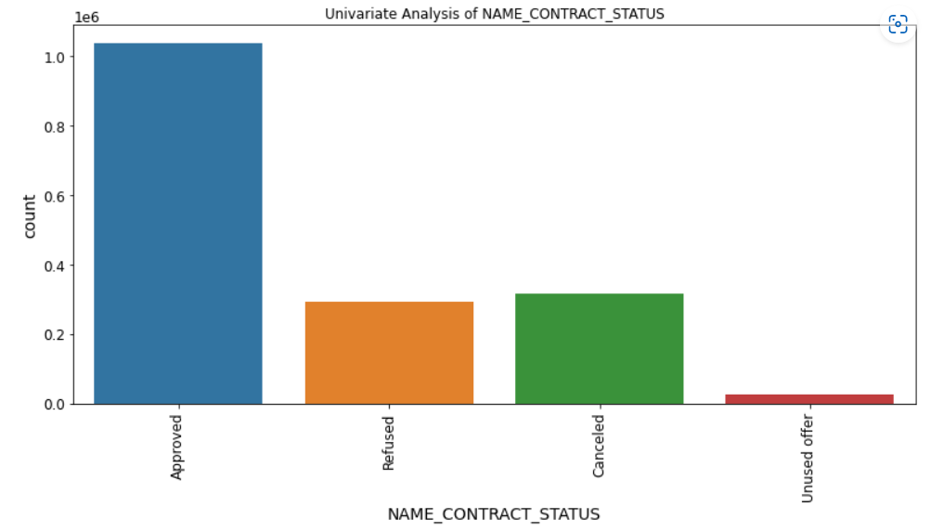
CONTRACT STATUS ANALYSIS
Approved loans outnumbered the Cancelled,Refused and Unused offer.
Second is cancelled and cancelled and Refused have minor difference in count

Slide 28
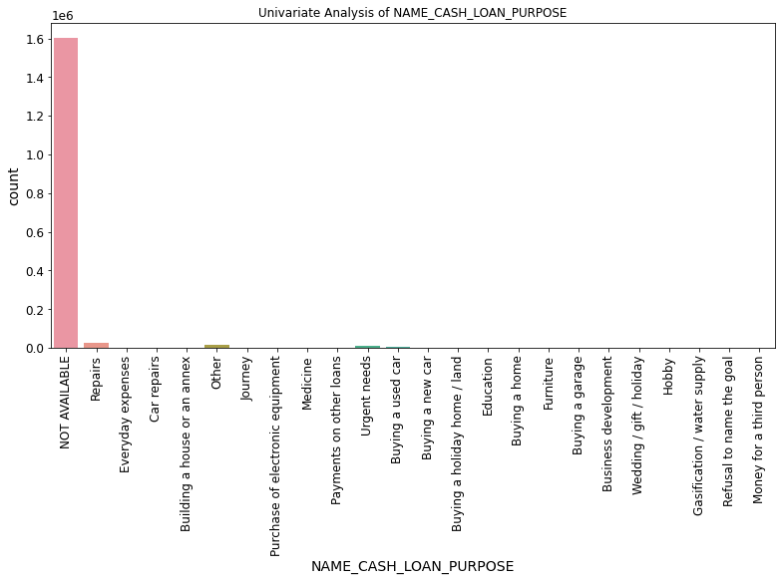
CASH LOAN PURPOSE
Majority of the clients use loan for repairs,other and urgent needs.Rest of the parameters have negligible participation

Slide 29
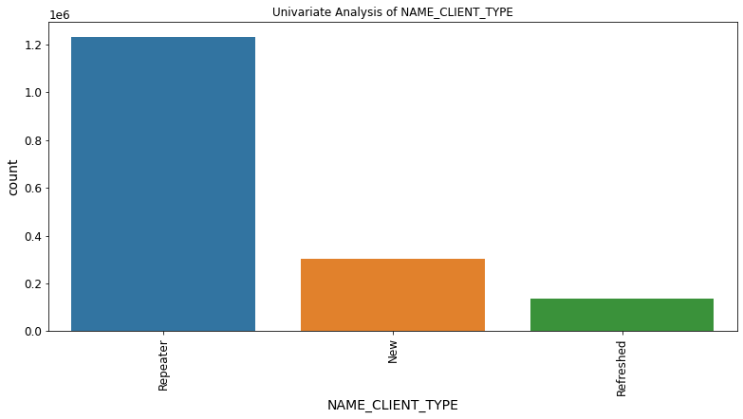
CLIENT TYPE ANALYSIS
Already existing client outnumbered New clients

Slide 30
BIVARIATE ANALYSIS

Slide 31
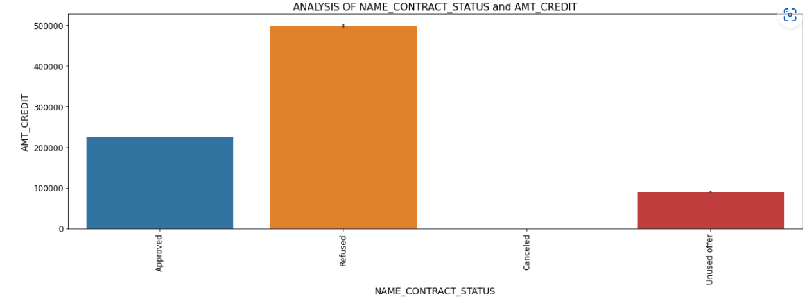
CONTRACT STATUS Vs CREDIT AMOUNT
Lower credit amount request has been approved previously.
Some unused offers are also there.Bank can concentrate on these unused offer ones

Slide 32
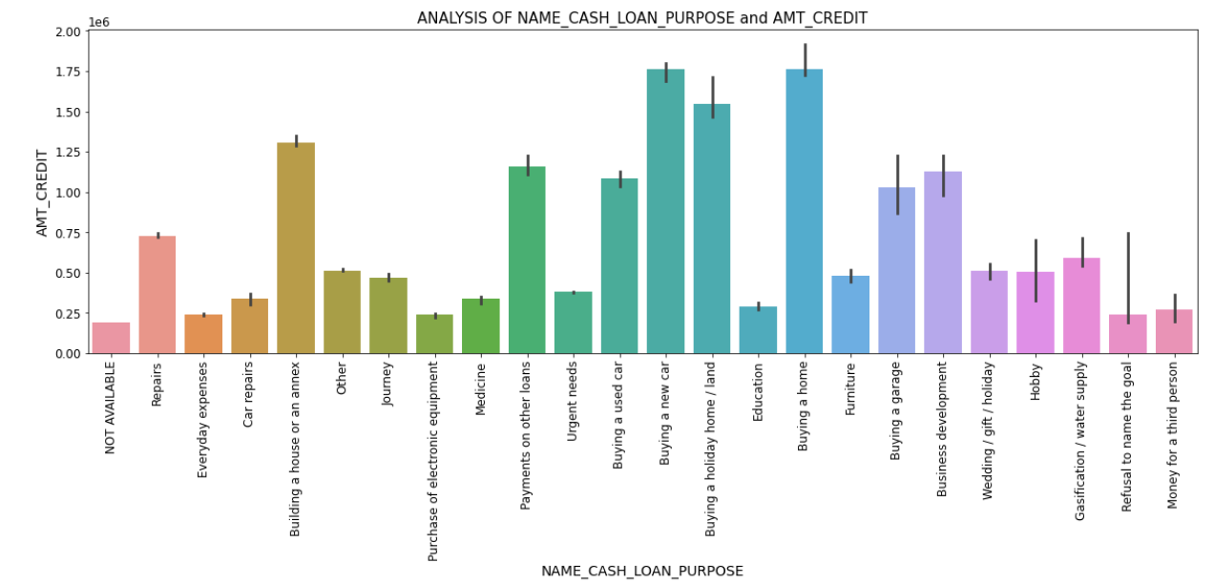
CASH LOAN PURPOSE Vs CREDIT AMOUNT
Buying a home,Buying a car,Buying a holidayhome/land got more credit than other categories.We know for these loans avail funds by providing your asset as collateral to the lender.So bank can promote this type of safer loans

Slide 33
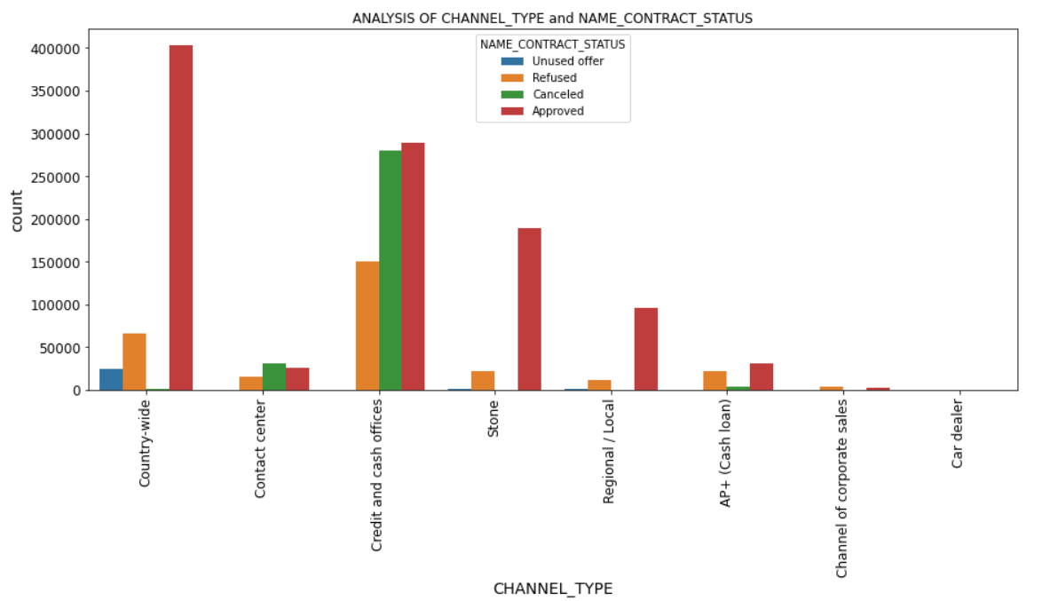
CONTRACT STATUS Vs CHANNEL TYPE
Country_wide channel has more approved loans than others followed by Credit and cash offices
Refused and cancelled have more number in Credit and cash offices

Slide 34
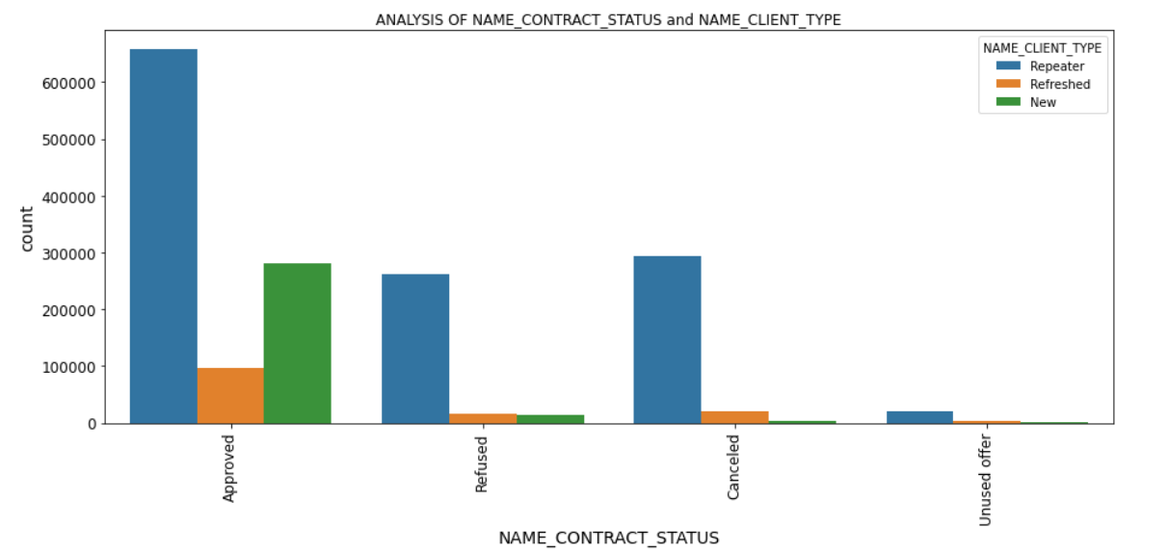
CONTRACT STATUS Vs CLIENT TYPE
Repeaters or Old clients has higher approval rates than new ones

Slide 35
MERGED DATA ANALYSIS

Slide 36
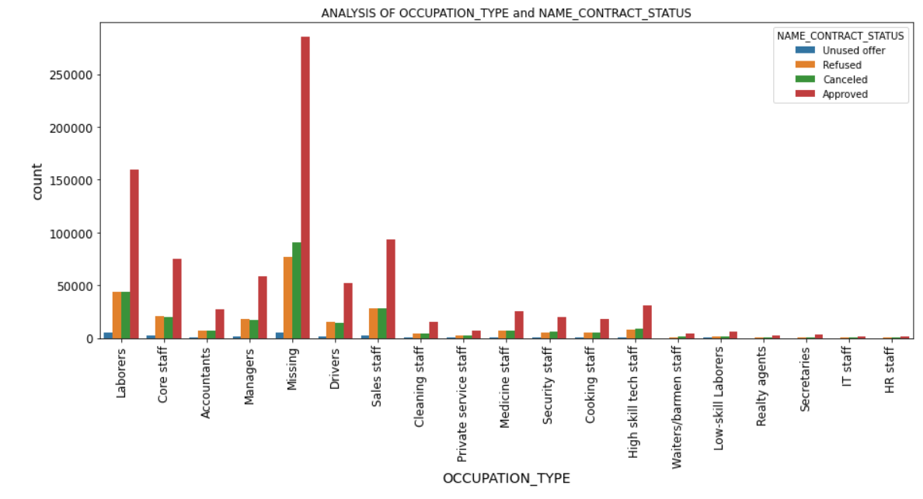
OCCUPATION Vs CONTRACT STATUS
High Loan approvals were given for Laborers and Sales staff.

Slide 37
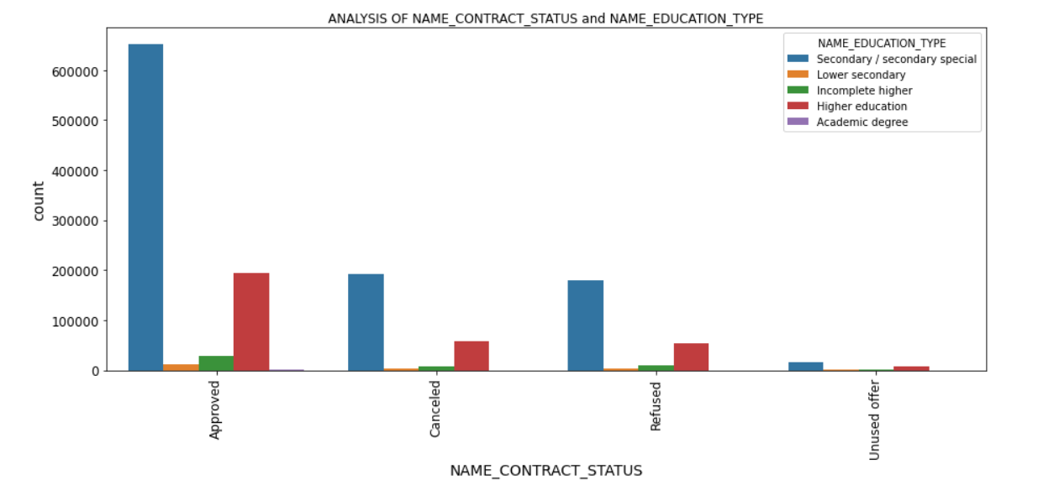
EDUCATION TYPE Vs CONTRACT STATUS
Secondary/Secondary special has got higher loan approvals followed by Higher Education in previous application.But they are high in defaulters category also

Slide 38
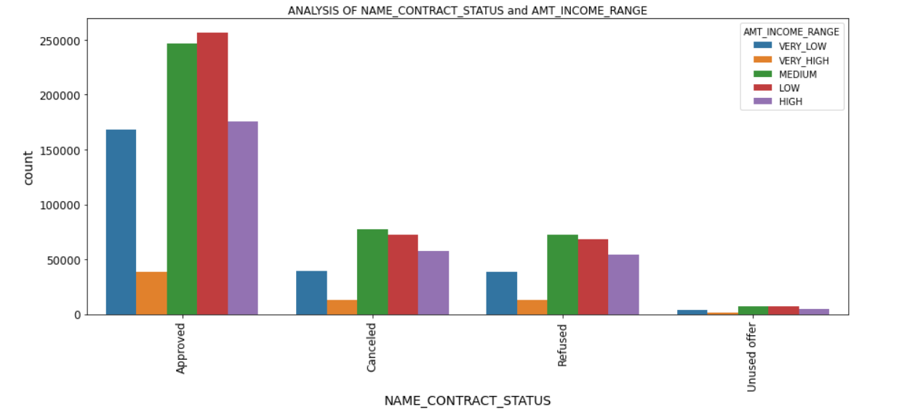
INCOME Vs CONTRACT STATUS
Low and Medium and very low income clients loan were approved more in previous application.But they are high in defaulters category also

Slide 39
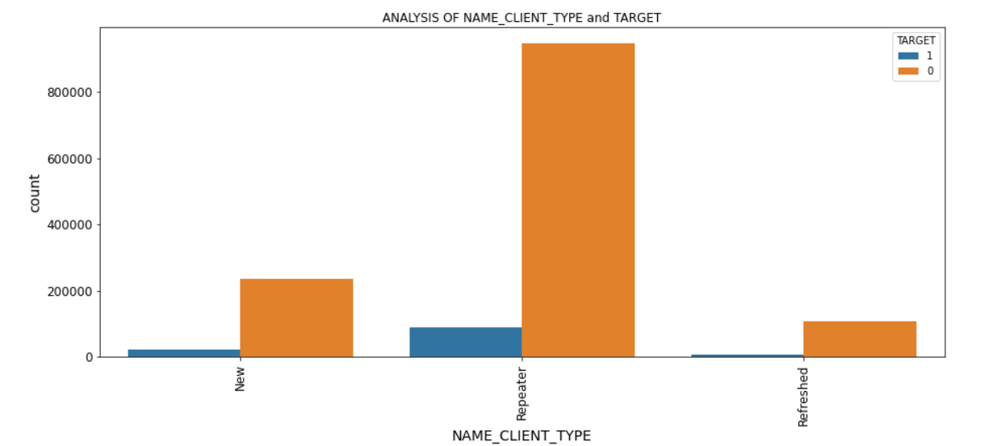
TARGET Vs CLIENT TYPE
Generally Repeaters or Old clients are ontime payers than New and Refreshed clients

Slide 40
CONCLUSION
Default rate for Females are less compared to Males.Males who are less in number tends to default more
Secondary or low level Education has high tendency to default compared to higher education levels,But their loan approval rate was very high
Occupation plays an important role in deciding whether customer being able to repay loan or not.People who have good jobs tends to default less
Loan Approval rate for Laborers are high.Their contribution to defaulting category is also high
Clients with Very-low & Low Income tends to default even for smaller credit amount but their loan approval rates were high
Businessman repays loan ontime even for high credit.Students also repays loan ontime.Maternity leave clients even their representation is less have more payment difficulties
Married clients have less default rate compared to their ontime payment percentage.Single clients have more payment difficulties compared to Ontime paying category
As Years of Employement increases payment difficulty decreases
Repeater or Old clients tends to pay ontime compared to fresh Applicants and their loan approval rate were high.

Slide 41
RECOMMENDATION
Company should focus more on Females when lending loans as they have high repaying tendency than Males
Loans for Buying a home,car,land avail funds by providing your asset as collateral to the lender.So Company can promote this type of safer loans instead of Repairs with low repayment percentage
Promote loans for Higher degree instead of Lower education levels.Higher check should be done on personal profile for lower education categories
As Businessman and students default less promoting loans at lower rate for them will enhance Profit
Focus less on working class as default more.Else increase interest rate for this category
More Preference should be given to existing clients as the default less
Promote Loan offers to experienced clients than less experienced clients
Be vigilant when providing loans to Low income clients as their defaulting rate is high even for lower credit amount
When lending loan to Laborers double check to be done as they have high defaulting rate.Promote Loan offers to clients with good jobs

Slide 42
THANK YOU

